Slide 1
Data structure algorithm Linked List
Arguelles, Jerald Braganza, Charlie Corpus, Kathlene Dela Serna, Justine Graagasin, Rommel Gutierrez, Christian Lim, Camille Lim, Christopher
Prof. Luna, Jenelyn E.

Slide 2

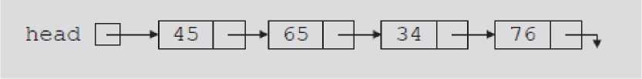

Objectives
• Learn about linked list
• Learn the properties, logic, and operations of link list
• Learn the difference between singly and doubly linked list
1. Introduction -
Linked list is a collections of components (nodes)
• Nodes
Data: Stores relevant information Link: Stores address
Structure of a node
• Head (first)
- Address of the first node in the list
• Arrow points to node address
- Stored in node
• Down arrow in last node indicates NULL link field
Linked list
Linked list and values of the links

Slide 3
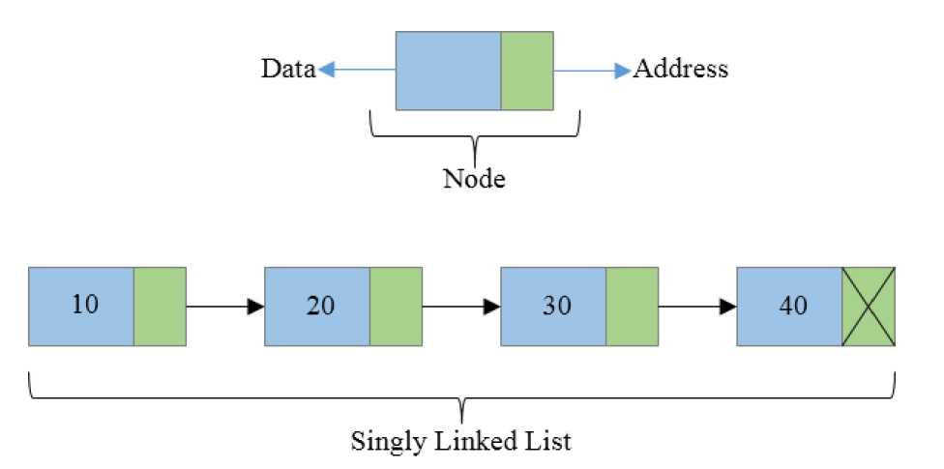
2.0 Singly - Linked List -
Singly linked list is a basic linked list type. Singly linked list is a collection of nodes linked together in a sequential way where each node of singly linked list contains a data field and an address field which contains the reference of the next node. Singly linked list can contain multiple data fields but should contain at least single address field pointing to its connected next node.
Basic structure of a singly linked list
struct node {
int data; // Data struct node * next; // Address
};

Slide 4
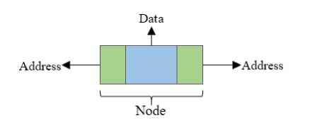
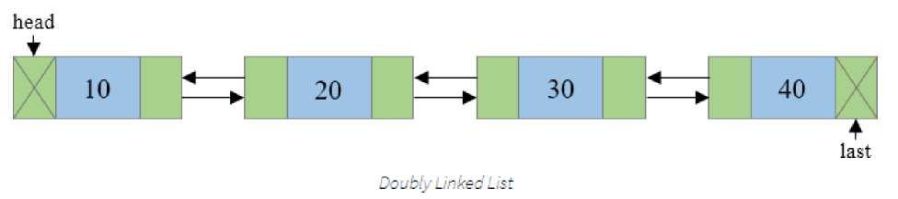
3.0 Doubly - Linked List -
Doubly linked list is a collection of nodes linked together in a sequential way. Each node of the list contains two parts (as in singly linked list) data part and the reference or address part. The basic structure of node is shown in the below image:
Basic structure of a doubly linked list
struct node {
int data; // Data field
struct node * prev; // Address of previous node
struct node * next; // Address of next node
};

Slide 5
4.0 Java Code for Linked List -
// Creating object of the class linked list and adding elements to the link list
import java.util.LinkedList;
public class sampleLinkedList {
public static void main(String args[])
{
// Creating object of class linked list LinkedList<String> object = new LinkedList<String>();
// Adding elements to the linked list
object.add("A");
object.add("B");
object.add Last("C");
object.addFirst("D");
object.add(2, "E");
object.add("F");
object.add("G");
System.out.println("Linked list : " + object);
}
}
OUTPUT:
Linked list: [D, A, E, B, G, F, C]

Slide 6
// Removing elements from the linked list
object.remove(“A");
object.remove(3);
object.removeFirst();
object.removeLast();
System.out.println("Linked list after deletion: " + object);
System.out.print("Enter the element to delete: ");
int n = in.nextInt();
object.remove(n);
System.out.println("Linked list after deletion with user input: " + object);
}
}}
Enter the element to delete: 5
Linked list: [D, A, E, B, G, F, C]
Linked list after deletion: [E, F]
4.1 Java Code for Linked List -
// Removing elements from the linked list
import java.util.LinkedList;
import java.util.Scanner;
public class sample {
public static void main(String[] args) {
// TODO Auto-generated method stub
//Creating object of the class linked list and adding elements to the link list import java.util.
{
//Creating object of class linked list
LinkedList<String> object = new LinkedList<String>();
//Adding elements to the linked list
Scanner in = new Scanner(System.in);
// Adding elements to the linked list
object.add("A");
object.add("B");
object.addLast("C");
object.addFirst("D");
object.add(2, "E");
object.add("F");
object.add("G");
System.out.println("Linked list : " + object);

Slide 7
4.2 Java Code for Linked List -
//Finding elements on the linked list
import java.util.LinkedList;
public class linked List {
public static void main(String args[])
{
// Creating object of class linked list LinkedList<String> object = new Linked List<String>();
// Adding elements to the linked list
object.add("A");
object.add("B");
object.add Last("C");
object.addFirst("D");
object.add(2, "E");
object.add("F");
object.add("G");
System.out.println("Linked list : " + object);
// Finding elements in the linked list boolean status = object.contains("E");
if(status)
System.out.println("List contains the element 'E' "); else
System.out.println("List doesn't contain the element 'E'");
}
}
OUTPUT:
Linked list: [D, A, E, B, G, F, C]
List contains the element 'E'

Slide 8
4.3 Java Code for Linked List -
//Finding the size of linked list import java.util.LinkedList;
public class linked List {
public static void main(String args[])
{
// Creating object of class linked list
LinkedList<String> object = new LinkedList<String>(); // Adding elements to the linked list
// Adding elements to the linked list
object.add("A");
object.add("B");
object.add Last("C");
object.addFirst("D");
object.add(2, "E");
object.add("F");
object.add("G");
System.out.println("Linked list : " + object);
}
// Number of elements in the linked list int size = object.size();
System.out.println("Size of linked list = " + size);
}
}
OUTPUT:
Linked list: [D, A, E, B, G, F, C] Size of linked list = 7

Slide 9
4.3 Java Code for Linked List -
//Add element/node using user input
import java.util.LinkedList;
Import java.util.Scanner;
public class linked List {
public static void main(String args[])
{
// Creating object of class linked list
Scanner in = new Scanner(System.in);
LinkedList<String> object = new LinkedList<String>();
// Adding elements to the linked list
// Adding elements to the linked list
object.add("A");
object.add("B");
object.add Last("C");
object.addFirst("D");
object.add(2, "E");
object.add("F");
object.add("G");
System.out.println("Linked list : " + object);
}
System.out.print("Insert another element: ");
String n = in.next();
System.out.print("Enter Address: ");
int p = in.nextInt();
object.add(p,n);
System.out.println("Linked list after input: " + object);
}
}
Insert another element: Z
Enter address: 8
OUTPUT:
Linked list before input: [D, A, E, B, G, F, C]
Linked list after input: [D, A, E, B, C, F, G, Z]

Slide 10
END

